Slide 1
Divide and Conquer Approach Dr. Tathagata Ray Assistant Professor, BITS Pilani, Hyderabad Campus rayt@hyderabad.bits-pilani.ac.in

Slide 2
Substituition Method
The substitution method is used for solving recurrences.
Two step process
Step 1: Guess the form of the solution
Step 2: Use mathematical induction to find the constants and show that the solution works.

Slide 3
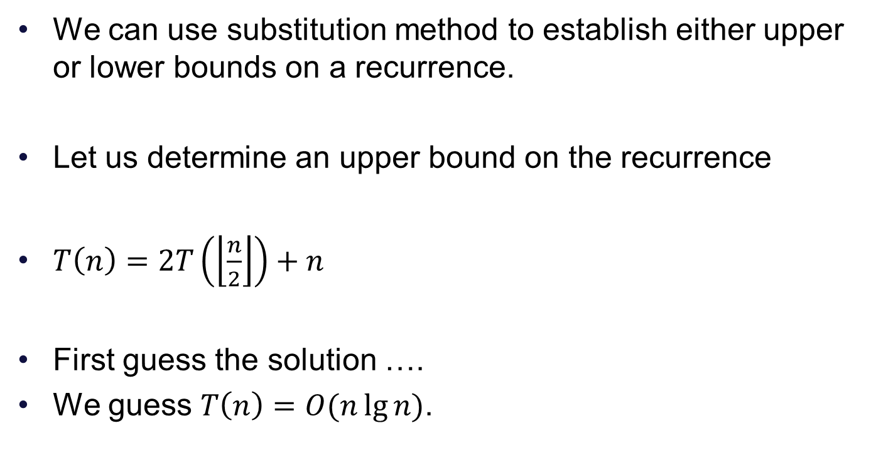
Example
We can use substitution method to establish either upper or lower bounds on a recurrence.
Let us determine an upper bound on the recurrence
$T\left(n\right)=2T\left(\left\lfloor \frac{n}{2}\right\rfloor \right)+n$
First guess the solution ….
We guess $T\left(n\right)=O(n\lg{n)}$.

Slide 4
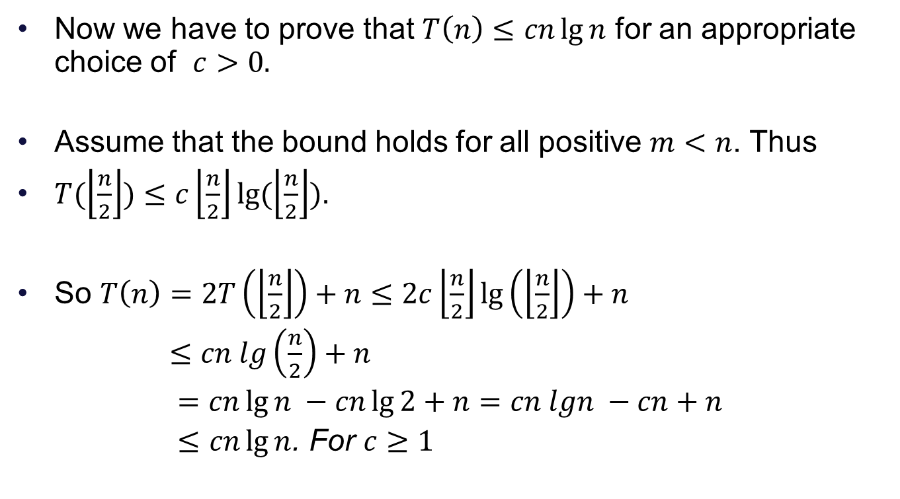
Next step
Now we have to prove that $T\left(n\right)≤cn\lg{n}$ for an appropriate choice of $c>0.$
Assume that the bound holds for all positive $m<n$. Thus
$T(\left\lfloor \frac{n}{2}\right\rfloor )≤c\left\lfloor \frac{n}{2}\right\rfloor lg⁡(\left\lfloor \frac{n}{2}\right\rfloor )$.
So $T\left(n\right)=2T\left(\left\lfloor \frac{n}{2}\right\rfloor \right)+n≤2c\left\lfloor \frac{n}{2}\right\rfloor \lg\left(\left\lfloor \frac{n}{2}\right\rfloor \right)+n$
$≤cn lg\left(\frac{n}{2}\right)+n$
$=cn\lg{n} −cn\lg{2}+n=cn lgn −cn+n$
$≤cn\lg{n}$. For $c≥1$

Slide 5
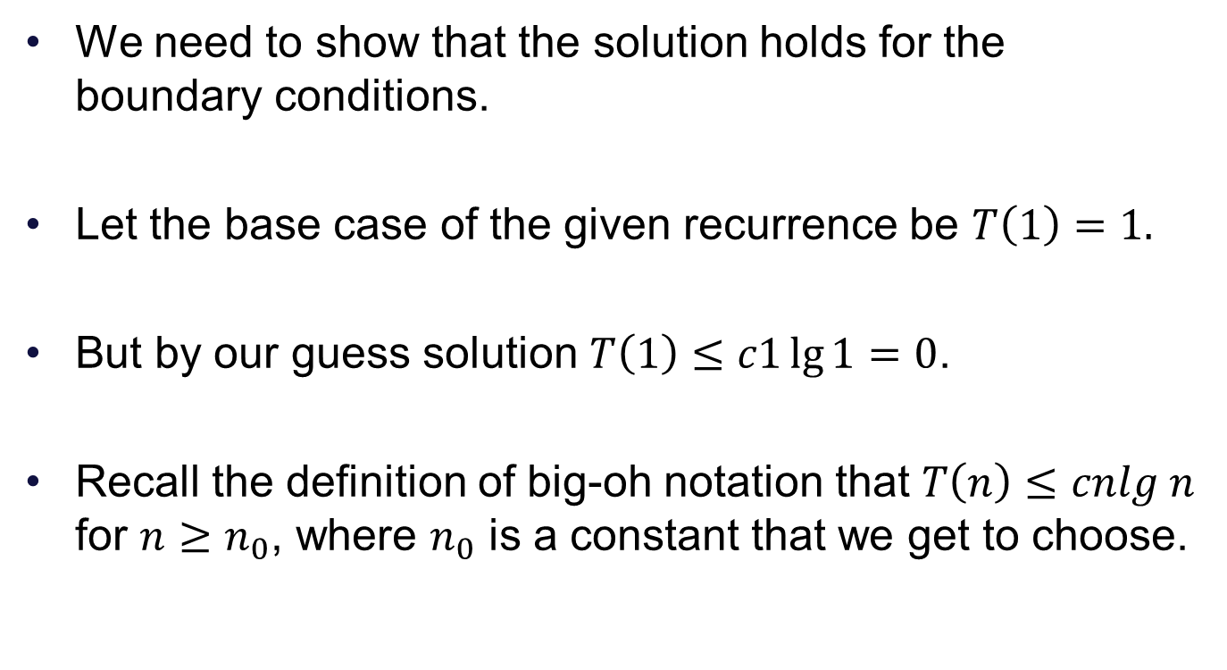
Next step
We need to show that the solution holds for the boundary conditions.
Let the base case of the given recurrence be $T\left(1\right)=1.$
But by our guess solution $T\left(1\right)≤c1\lg{1}=0$.
Recall the definition of big-oh notation that $T\left(n\right)≤cnlg n$ for $n≥n_{0}$, where $n_{0}$ is a constant that we get to choose.

Slide 6
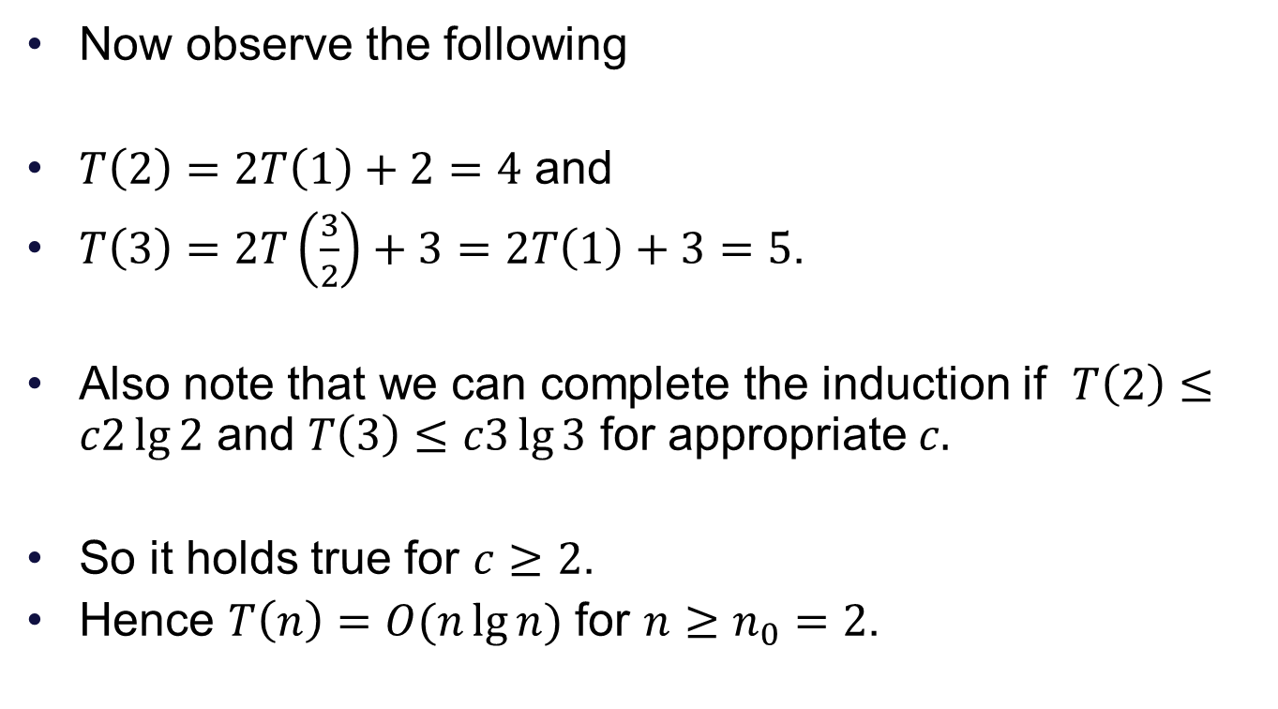
Completing the induction
Now observe the following
$T\left(2\right)=2T\left(1\right)+2=4$ and
$T\left(3\right)=2T\left(\frac{3}{2}\right)+3=2T\left(1\right)+3=5$.
Also note that we can complete the induction if $T\left(2\right)≤c2\lg{2}$ and $T\left(3\right)≤c3\lg{3}$ for appropriate $c.$
So it holds true for $c≥2$.
Hence $T\left(n\right)=O(n\lg{n})$ for $n≥n_{0}=2$.

